Slide 1
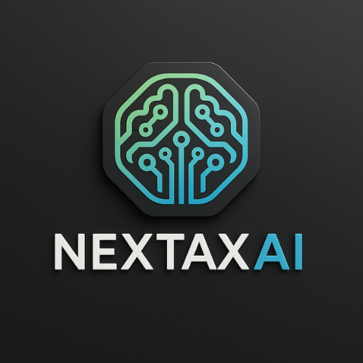

LLC or S Corp: Which Entity is Right for You?

Slide 2
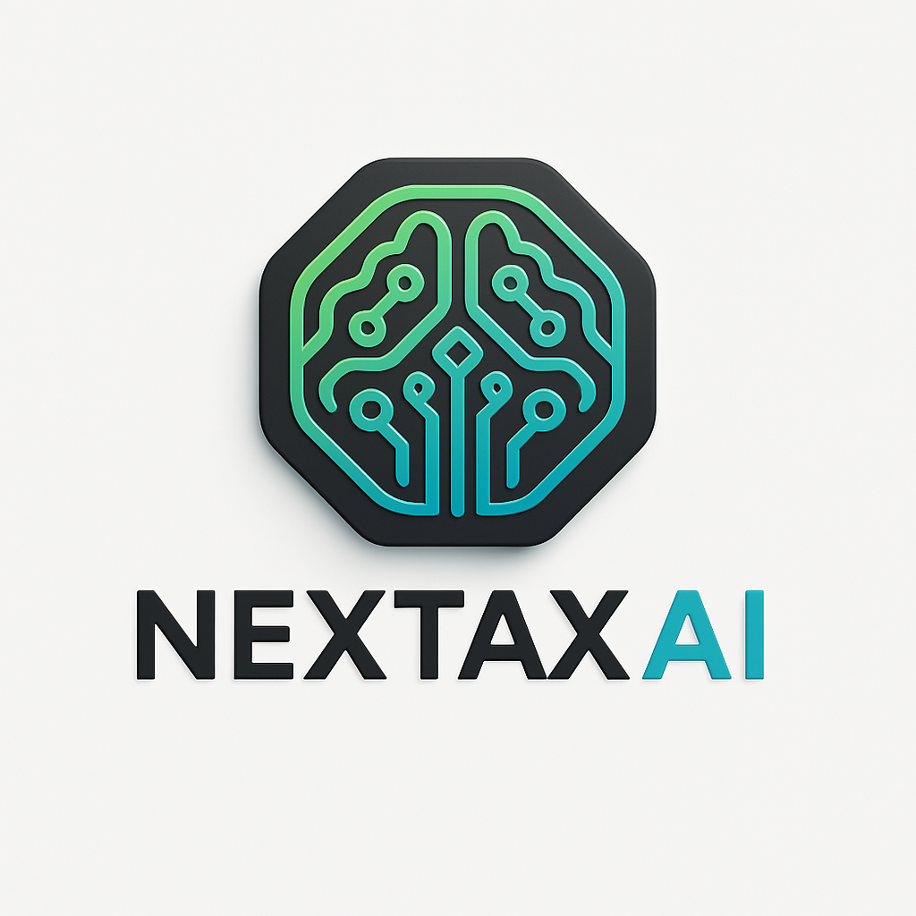
What is an S Corporation?
Entrepreneurs, Solopreneurs, and Founders
Launching a U.S. Business? We Can Help.
S Corporation is an LLC or a C Corporation that elected pass-through tax treatment with the IRS.
A company must meet strict requirements with the IRS to qualify for S Corporation status.
Must be owned by shareholders and run by board of directors.
Must hold an annual shareholders’ meeting and directors’ meetings, document key shareholder decisions, and file separate corporate income tax return.
Tax designation is granted by the IRS that lets corporations pass their income through to their shareholders.
💡 Launch Your U.S. Business in 48 Hours
✅ LLC + EIN + Compliance
🧠 AI-Powered. Tax-Optimized.
→ Start Now at www.nextax.ai

Slide 3
S Corporation Tax Advantages
• Lessens the Self-Employment Tax Burden on LLC Members
• Only income paid to LLC members on payroll is subject to self-employment
taxes.
• Profits paid as distributions are not subject to Social Security and Medicare taxes
so LLC members may find that the S Corporation election lowers personal tax
burden.

Slide 4
S Corporation Tax Advantages (continued)
Enables C Corporations to Avoid Double Taxation –
• As an S Corporation, a Corporation’s profits and losses flow through to
shareholders’ personal tax returns and are taxed at the individual tax rates.
• The corporate entity does not pay income tax.
• Shareholders that are employees of the C Corporation only pay self-employment
tax on the wages or salary that the Corporation pays them.
• Dividend income paid to shareholders is not subject to self-employment tax;
those monies are taxed as either ordinary income or qualified dividends.

Slide 5
S Corporation Tax Disadvantages
 May limit growth potential.
 S Corporations may not have more than 100 shareholders, so growth potential may be limiting.
 Understanding and adhering to the requirements of reasonable
compensation is important for maintaining compliance.
 An LLC taxed as an S Corporation must pay its owners fair compensation for the work they perform to avoid red flags with the IRS.
 S Corporations are not treated equally at the state level.

Slide 6
What is an LLC?
Entrepreneurs, Solopreneurs, and Founders
Launching a U.S. Business? We Can Help.
An LLC is an abbreviation for Limited Liability Company.
A Limited Liability Company is a business structure formed under specific state statutes.
This formal business structure is the simplest to form and maintain.
It is a hybrid of a Partnership and a Corporation.
It is a separate legal entity from its owners (known as “members”).
The main benefit is, as the name suggests, limiting liability of the owners.
The other advantage is that profits are taxed as personal income, and this is usually lower than what corporations pay.
💡 Launch Your U.S. Business in less than 48 Hours
✅ LLC + EIN + Compliance
🧠 AI-Powered. Tax-Optimized.
Trusted by 100+ entrepreneurs.
→ Start Now at www.nextax.ai

Slide 7
Benefits of Forming an LLC
 Simplicity – The business registration paperwork to form an LLC is
minimal as are the ongoing filing requirements.
 Personal Liability Protection - Because an LLC is considered a separate
legal entity from its members, its financial and legal responsibilities are
also its own.
 Financing and Credit - Financing can be easier to obtain because the LLC is a formal legal entity with known assets and obligations.
 Tax Treatment Options - By default, an LLC is considered a “disregarded entity” for tax purposes. As such, income tax is applied in the same way as it is to Sole Proprietorships and Partnerships.
 Management Flexibility - An LLC may be either member managed or
manager managed.

Slide 8
Tax Advantages of an LLC
 As a “disregarded entity” for tax purposes, an LLC’s profits and losses
flow through to its members’ personal tax returns, so income taxes are
paid at the individual owner level rather than at the entity level.
 The LLC offers a lot more flexibility in terms of how owners can be taxed.
 LLC members may choose how their business will divide the company’s profits and losses among its owners.
 LLC members may elect to have their LLC treated as a C Corporation or S Corporation.

Slide 9
Tax Disadvantages of an LLC
 All of an LLC’s business profits are subject to Social Security and Medicare taxes.
 This may create an unfavorable financial situation for LLC owners.
 They must pay self-employment taxes on their distributive share of the LLC’s profits, even if they invest that money back into the business.

Slide 10
How LLC Owners Get Paid
Payment Considerations –
 Sole Proprietors are not employees of the company, and therefore, do not receive a W2.
 Partnerships report business income on the 1065 partnership tax return,
and members pay self-employment taxes on their shares of the business
income.
 In single-member LLCs and multi-member LLCs that elect to file taxes as a C Corporation, all members are considered employees of the company and must receive a W2.
 LLCs that elect S Corporation status file a 1120S tax return, with
members receiving a Schedule K-1 form indicating their share of the
profits and losses.

Slide 11
Paying Social Security
 In general, all workers, including business owners, pay Social Security and Medicare taxes (called FICA) unless income is below $400 for the year.
 The Social Security tax rate on taxable wages is 6.2% each for the
employer and employee or 12.4% for both. The Medicare tax rate is
1.45% each for the employee and employer.
 In addition, employers are responsible for paying state unemployment
taxes for each employee (the rate varies by state).
 Sole Proprietorships, General Partners, and LLC members treated as Partnerships do not pay state unemployment taxes.

Slide 12
Payment Via 1099s
 Another option for paying yourself is having the LLC hire you as an independent contractor.
 You are still responsible for paying self-employment taxes, and you must follow the rules for independent contractors.
 What kind of tax benefits are still available to your company, and as an LLC are not as clear, so it’s essential to talk to your accountant before using the independent contractor option.

Slide 13
How S-Corporation Owners Get Paid
Payment Considerations –
 An S Corporation shareholder who does substantial work for the company is
considered an employee and must take a reasonable salary via payroll.
 The business must put the shareholder on payroll and compensate the
shareholder through a reasonable salary - from which taxes are withheld.
 An S Corporation’s profits are taxable at the shareholder level. Distributions
of these profits can be made to shareholders tax free.
 S Corporation owners can run into trouble if they pay themselves a
suspiciously small salary and then take most of their compensation in the
form of distributions to minimize the amount of taxes they must pay.
 The IRS can revoke an S Corporation status if they determine shareholders
are substantially underpaid for the services they provide.
 It is critical to maintain and track shareholder basis in an S Corporation. Tax
free distributions can be made to the shareholder as long as there is
sufficient basis. Shareholder basis has become an examination area by the
IRS.

Slide 14
Pass-Through Entity Tax Considerations
Income Tax –
 Taxes of a pass-through entity flow through to the owners’ individual tax returns.
 Business profits are taxed at the individual owner’s personal tax rate
rather than the corporate tax rate.
 This will be advantageous overall if the owner’s individual tax rates
are lower than the standard corporate tax rate.
 But many factors can come into play, such as state tax laws where a business is located, in determining what is best.

Slide 15
Federal tax overview for the different entity types.
Income Tax for LLCs :
Single-Member LLCs –
Income tax is handled the same way as a Sole Proprietorship.
Business income and losses flow through to the owner’s personal income tax return.
Multi-Member LLCs –
Income tax is handled the same as Partnerships.
They receive a Schedule K-1 from the LLC based on their share of the business’s profits.
Then they must report that information in Schedule E of their Form 1040.

Slide 16
Income Tax for S Corporations
An S Corporation’s income taxes pass through to its owners, but tax filing requirements depend on the underlying business entity.
The S Corporation is not a type of business entity but a special tax election that eligible LLCs and C Corporations may request from the IRS.

Slide 17
Self-Employment Tax
 The owners of pass-through entities are subject to self-employment taxes under SECA (the Self-Employment Contributions Act of 1954).
 Self-employment taxes include Social Security and Medicare taxes.
 Self-employed individuals must pay the entire 12.4% Social Security tax and 2.9% Medicare tax, which totals 15.3% to the federal government.
 Typically, they must pay these in quarterly installments with their
estimated income taxes.

Slide 18
Self-Employment Tax for S Corporations
 In S Corporations, the self-employment tax burden on the business
owners is lessened because individuals only pay SECA tax on their
wages and salaries from the business.
 The individuals’ “employee income” from their wages is subject to 50% of the Social Security and Medicare taxes and withheld from their paychecks. The S Corp pays the other 50% of those taxes.
 The remaining business profits paid as distributions to the S Corporation owners are subject to income tax but not self-employment taxes.
 Be aware that entrepreneurs must pay themselves a reasonable salary. If they try to game the system, the IRS may become suspicious and initiate an audit.

Slide 19
S Corporation vs. LLC Summary
Ownership Eligibility –
 The eligibility requirements to become an S Corporation shareholder are more
restrictive than those for an LLC.
 To elect tax treatment as an S Corporation, an LLC must be a domestic company
with owners who are individuals, certain trusts, or estates.
 Partnerships, Corporations, and non-resident aliens may not be S Corporation
shareholders.
 Other restrictions on S Corporations are a limit of only up to 100 shareholders and
the stipulation that they issue only one class of stock.
Liability Protection –
 Both the LLC and S Corporation protect business owners’ personal assets.
 However, a court might rule that an LLC’s members or S Corporation’s shareholders
are personally responsible for debts and legal issues of the business if they acted
fraudulently, personally guaranteed business loans, or were negligent or reckless in
some way that caused harm.

Slide 20
S Corporation vs. LLC Summary
Business Income –
 To get paid by the business, LLC members take money out of their share of its profits.
 An S Corporation’s owners (called “shareholders”) who do substantial work for the S Corporation are considered employees and must be on the company payroll.
Pass-Through Taxation –
 By default, an LLC is considered by the IRS to be the same tax-paying entity as its owners. LLC members are responsible for income tax and self-employment taxes (Social Security and Medicare) on their company profits.
 With S Corporation tax treatment, LLC members still have pass-through taxation. However, the owners only pay Social Security and Medicare taxes on their wages and salaries from the business. Income taken as distributions is not subject to self- employment taxes.

Slide 21
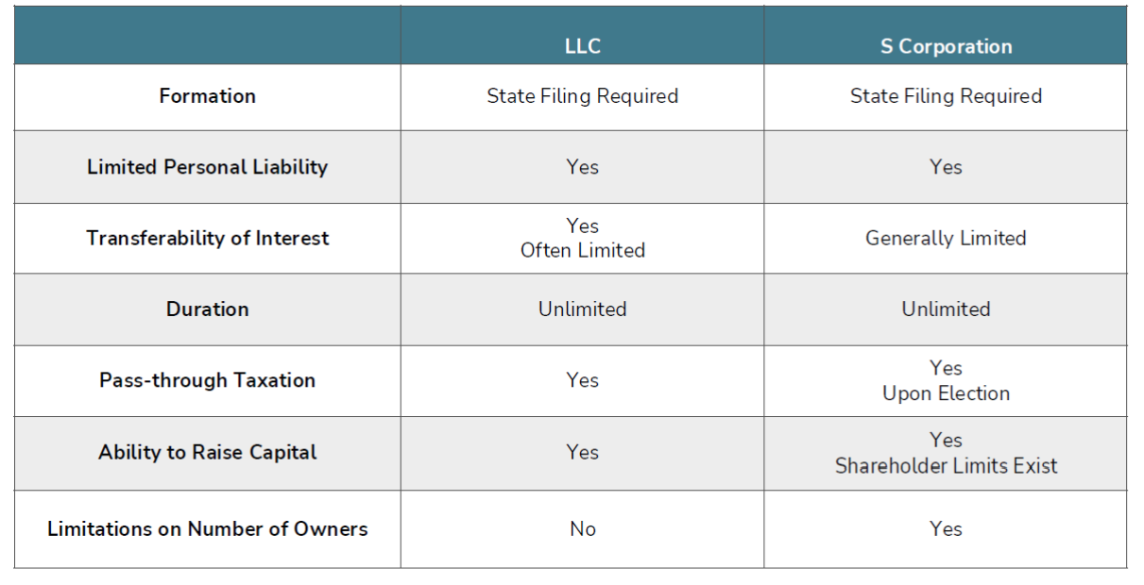
LLC vs S Corp Comparison

Slide 22
Choosing an Entity Type
What Should Be Considered?
 Where business will be conducted
 Wanting to have limited personal liability for business activities
 Whether the business will have a partner or an investor
 The company’s expected earnings and deductions
 Desire to minimize self-employment tax obligation
 Business goals
 Tolerance for compliance formalities
 Registration and administrative costs to set up and maintain a
business structure

Slide 23
S Corporation Example:
Authorized vs. Issued Stock
Scenario:
 Oliva’s business is growing, and she’s decided she needs liability protections.
 Her business plan also includes offering stock to help fuel her growth.
 If she structures her company as LLC, she won’t be able to offer stock.
 If she chooses to be a C Corporation, she could offer stock, but she must determine how many authorized stock shares the company will have at the time she incorporates.
 If she wants to change the number of authorized stock shares, she will need to amend the articles of incorporation.
Solution:
As an S Corporation, she can set aside a portion of stock shares that can be offered to future investors without having to amend the articles of incorporation or have a shareholder vote to increase authorized shares.

Slide 24
S Corporation Example: Seeking Investors
Scenario:
 Joe’s business is relatively young, but he has a great idea that will put the company on a fast track for growth.
 To implement his ideas, he needs substantial financing.
Solution:
He and his accountant have decided that offering common stock is his best option, so electing S Corporation status is his best option.

Slide 25
S Corporation Example: Reducing a Large Tax Burden
Scenario:
 Emma’s business is a C Corp and it’s doing very well.
 In fact, she has reached a point where the double taxation she experiences as a C Corp is becoming a financial burden.
 She is eager to avoid double taxation since she must pay corporate taxes.
 Plus, her payroll taxes are significant.
Solution:
As an S Corporation, she would no longer have to pay corporate taxes and she can distribute dividends to lower the amount of money that goes toward paying self- employment taxes.

Slide 26
LLC Example: Being a Sole Owner
Scenario:
 Dave is a Sole Proprietor and runs a small website selling kids toys.
 Dave is very busy and has no staff, so sometimes he inadvertently mixed his business and personal funds.
 His lawyer wants him to incorporate so he can gain liability protection, and his accountant told him he could get in trouble if he didn’t keep his finances separate.
Solution:
Now, as a single-member LLC owner, Dave gained the liability protection of an LLC offers and is more vigilant about keeping his personal assets separated from the company’s assets.

Slide 27
LLC Example: Startup Business
Scenario and Solution:
 When choosing her business structure at startup, Lauren explored her options and chose to be an LLC.
 Forming an LLC gave her the liability protections of a Corporation and saved her money both initially and on an ongoing basis.
 LLCs are more flexible than Corporations to run, cost less to start up, and require less paperwork.

Slide 28
LLC Example: Long-term Company and No Stock
Scenario:
 Mike’s graphic design is doing well, but he wants to hire a few core employees and stay relatively small.
 However, he also needs liability protection.
Solution:
 Selecting an LLC business structure makes the most sense because it’s simpler and less complex than becoming a C Corporation.
 And he never plans to issue stock, so an LLC makes sense.

Slide 29
Does an S Corporation Election Make Sense for Your LLC?
 If you are looking to avoid many formalities of a C Corporation
(Minutes, Board of Directors, Annual Meetings, etc.) an LLC with S
Corporation election would be a good fit.
 If you are looking to stay in business long-term, an LLC with an S
Corporation election could be a wise choice.
 An LLC owner that elects to file as an S Corporation would take
payroll instead of guaranteed payments, limiting self-employment tax, which could be appealing to many clients.
 Forming an LLC with an S Corporation election is a wise choice if you intend to file as a Partnership or Sole Proprietor in the future.

Slide 30
How to Form an LLC
When to Form Your LLC –
 Often, it’s best to file an LLC as soon as possible after starting a business. After all, the main benefit is liability protection. By waiting, business owners expose themselves to liability.
 An LLC’s start date is not retroactive. As a result, owners will probably need to file two sets of income tax returns for the business if it changes to an LLC mid-year. For example, if an LLC was formed on June 1, its owner(s) would need to file taxes as a Sole Proprietor or Partnership from January 1 through May 31 and then file taxes as an LLC from June 1 through December 31.

Slide 31
Where to Form Your LLC
 Once you decide to start a new business, you must choose the state to form your LLC.
 If you have a small business, the general norm is to incorporate in your home state.
 Delaware and Nevada are also popular options.
 Delaware is chosen because it has the most developed and flexible corporate statutes in the country and is considered pro-business.
 Nevada is also popular because of its lack of state corporate income tax, franchise tax and personal income tax. It also has relatively low fees.

Slide 32
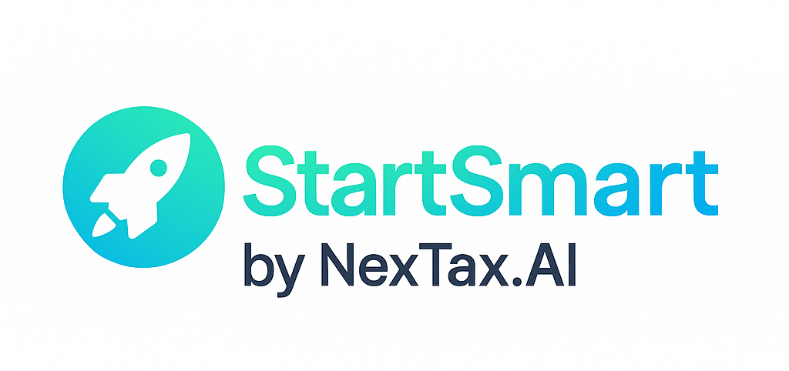
Steps to Form Your New Business
1. File Articles of Organization with the state
2. Designate a registered agent
3. Create an operating agreement
4. Obtain an EIN (employer identification number)
5. Request foreign qualification if operating in multiple states
6. Obtain business licenses and permits
7. Register for sales tax (applies to most states)
8. Start a business bank account
9. Register for payroll taxes (if you have employees)
💡 Launch Your U.S. Business in less than 48 Hours
✅ LLC + EIN + Compliance
🧠 AI-Powered. Tax-Optimized.
Trusted by 100+ entrepreneurs.
Visit www.nextax.ai and StartSmart with your new business launch, saving valuable time and money, through AI Powered automation.

Slide 33
How to Elect S Corporation Status for a Corporation or LLC
S Corporation Election Deadline –
 Form 2553 must be filed no later than two months and fifteen days after the start of the tax year in which the S corporation will take effect. For most businesses, the tax year begins on January 1, so the filing deadline would be March 15 (outside of leap years).
 Missing the deadline means the business will continue to be taxed as a C Corporation or LLC for the remainder of the tax year, with S Corporation treatment starting on January 1st of the following year.
 Newly formed LLCs and Corporations have two months and 15 days (75 days) from their date of formation to file for S Corporation election for the tax year.
 Business owners can request a six-month extension to file for S Corporation status by filing IRS Form 7004.

Slide 34
Eligibility for S Corporation Status
To qualify for status, a Corporation or LLC must meet the following requirements:
 Be a domestic Corporation
 Have only allowable shareholders
 May be individuals, certain trusts, and estates and
 May not be Partnerships, Corporations, or non-resident alien
shareholders
 Have no more than 100 shareholders
 Have only one class of stock
 Not be an ineligible Corporation - certain financial institutions, insurance companies, and domestic international sales corporations
 Submit Form 2553 Election by a Small Business Corporation signed by all shareholders by the March 15th deadline

Slide 35
Steps to Elect S Corporation Tax Status
1. Entity must first be incorporated as a C Corporation or have filed as an LLC.
2. A C Corporation electing S Corporation status must submit and file IRS form 2553 signed by all shareholders.
3. An LLC electing S Corporation status must submit and file IRS form 2553 signed by all shareholders.
4. An LLC electing to be taxed as a C Corporation must submit and file IRS Form 8832 signed by all shareholders.

Slide 36
What if the S Corporation Deadline is Missed?
 If a Corporation or LLC fails to timely file its IRS form 2553 with the IRS, the S Corporation election will NOT be effective for that year.
 A Corporation will be taxed as a C Corporation.
 A single-member LLC will be taxed as a disregarded entity and a multi-member LLC will be taxed as a Partnership.
 A late S Corporation election is generally effective for the next tax year. Relief for late election may be available if the Corporation or LLC can show that the failure to file on time was due to reasonable cause.

Slide 37
S Corporation Election at the State Level
Many States Have Different Rules –
 S Corporation election benefits can change at the state vs
federal level.
 Most states are given S Corporation pass-through tax
treatment, but there are exceptions.
 Critical that clients understand how this affects their
business.

Slide 38
State-Level S Corporation Election
Requirements: New Jersey
 State-level S Corporation tax treatment requires filing Form CBT-
2553.
 The state will only consider the election valid if all Corporation’s
shareholders consent to the election and other state requirements.
Requirements: New York
 New York state does not automatically treat a company as a New York
S Corporation unless mandated to file as an S Corporation under Tax
Law Section 660(i).
 New York requires a Corporation to file form CT-6 to apply for S
Corporation tax treatment at the state level.

Slide 39
State-Level S Corporation Election
Requirements: Arkansas
 It was not until 2018 that Arkansas recognized S Corporation tax
treatment at the state level without additional paperwork.
Requirements: Utah
 Utah requires a copy of a company’s Notice of Acceptance as an S
Corporation from the IRS.
 The notice must be attached to Form TC-20S the first time the
company files its tax return.

Slide 40
Where S Corporation Flow-Through Tax Treatment Does Not Exist
Some jurisdictions do not recognize S Corporation election. Tax agencies in the following areas do not grant pass-through taxation for Corporations that have been approved for federal S Corporation tax treatment.
 District of Columbia
 Louisiana
 New Hampshire
 New York City
 Tennessee
 Texas

Slide 41
States Without Personal or Corporate Income Taxes
S Corporation election is essentially a non-issue in some areas as there are no state income taxes at the personal or corporate level.
Note: some of these states, however, may enforce other types of fees to an S Corporation or its shareholders.
Alaska
Florida
Nevada
South Dakota
Washington
Wyoming

